Slide 1
JAVA Architecture presented by Uggina Lakshmi

Slide 2
Java Architecture
Java Architecture is a collection of components, i.e., JVM, JRE, and JDK.
It integrates the process of interpretation and compilation and it defines all the processes involved in creating a Java program.
Java Architecture explains each and every step of how a program is compiled and executed.
There is a process of compilation and interpretation in Java.
Java compiler converts the Java code into byte code.
After that, the JVM converts the byte code into machine code.
The machine code is then executed by the machine.

Slide 3
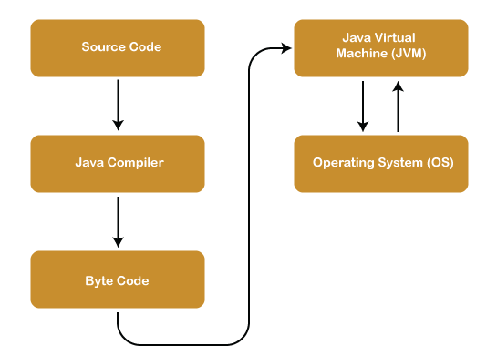
Architecture

Slide 4
Components of Java Architecture
Java Virtual Machine (JVM)
Java Runtime Environment (JRE)
Java Development Kit (JDK)

Slide 5
Java Vitual Machine
JVM(Java Virtual Machine) acts as a run-time engine to run Java applications. JVM is the one that actually calls the main method present in a java code. JVM is a part of JRE(Java Runtime Environment).
Java applications are called WORA (Write Once Run Anywhere). This means a programmer can develop Java code on one system and can expect it to run on any other Java-enabled system without any adjustment. This is all possible because of JVM.
When we compile a .java file, .class files(contains byte-code) with the same class names present in .java file are generated by the Java compiler. This .class file goes into various steps when we run it. These steps together describe the whole JVM.

Slide 6
Java Runtime Environment
Java Run-time Environment (JRE) is the part of the Java Development Kit (JDK).
It is a freely available software distribution which has Java Class Library, specific tools, and a stand-alone JVM.
It is the most common environment available on devices to run java programs.
The source Java code gets compiled and converted to Java bytecode. If you wish to run this bytecode on any platform, you require JRE.
The JRE loads classes, verify access to memory, and retrieves the system resources. JRE acts as a layer on the top of the operating system.

Slide 7
It is a software development environment used in the development of Java applications and applets. Java Development Kit holds JRE, a compiler, an interpreter or loader, and several development tools in it.

